Slide 1

Git – Common Problems
or what to do if you made a mistake

Slide 2


Gergel Gorvat
Front-End Developer

Slide 3
before we start
git status
git clone
git pull
git add
git commit
git push
git branch
git checkout
git merge
*this is what you have to know before we start

Slide 4
Roadmap
git branch
git log
git diff
git commit --amend
git revert
git reset
git merge
git rebase
git reflog
git clean
git stash
git cherry-pick
git branch delete
git blame

Slide 5
WHAT IS “HEAD”?
4594
← master
HEAD – feature →
fe91
2faf
003a
c87a
54a4
1913
c3ef

Slide 6
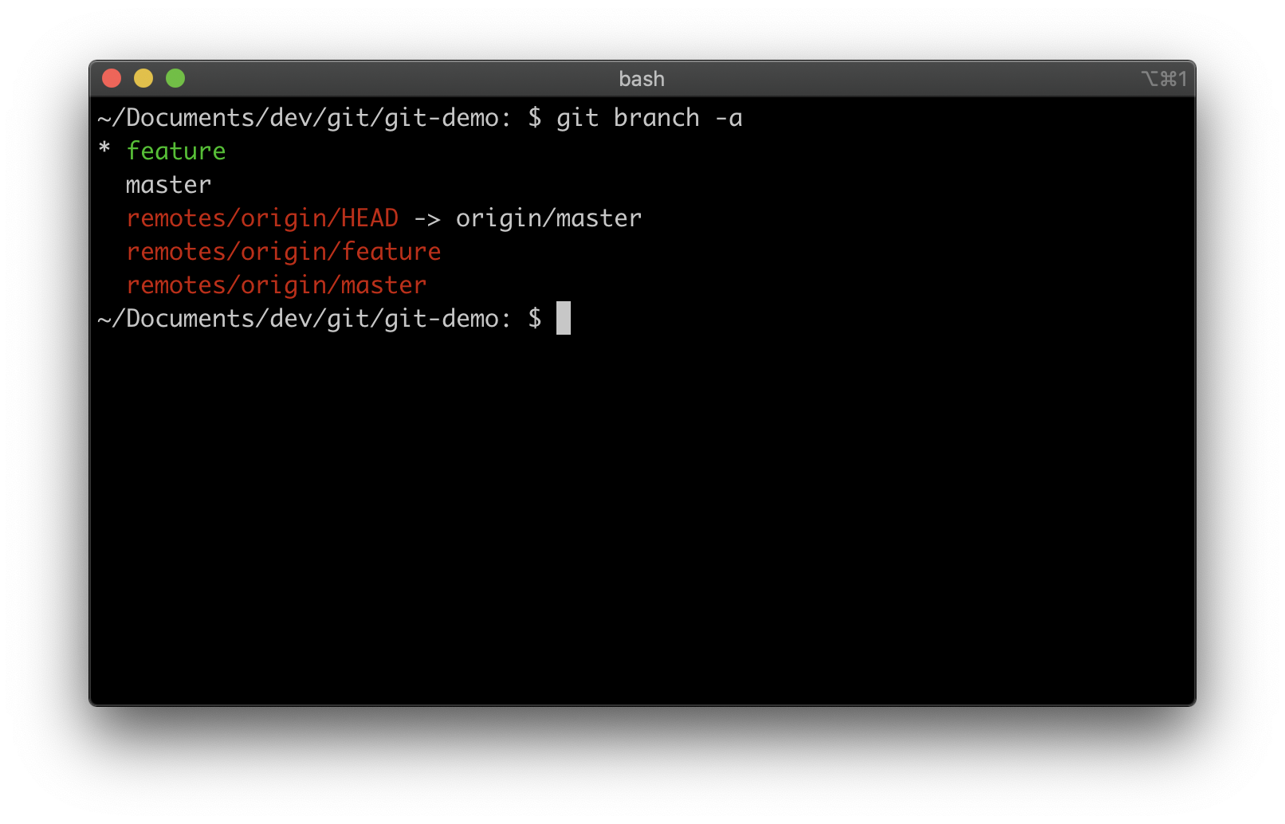
Branch list
git branch -a

Slide 7
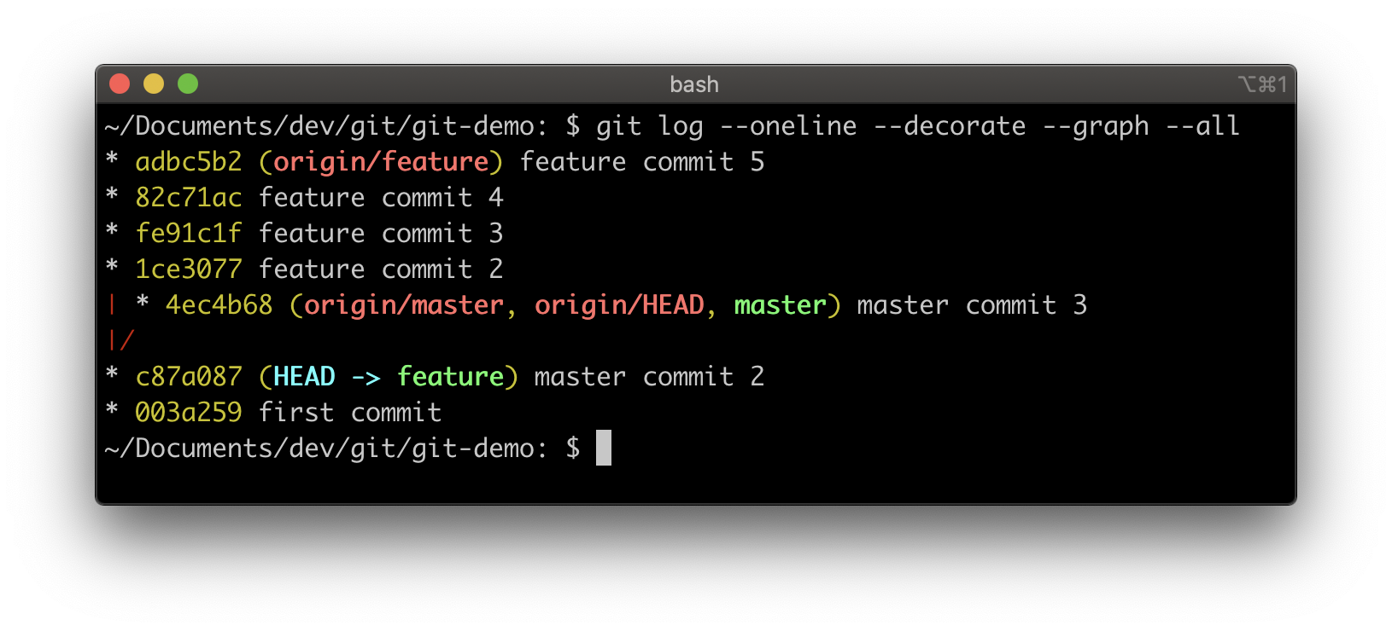
log
git log --oneline --decorate --graph --all

Slide 8
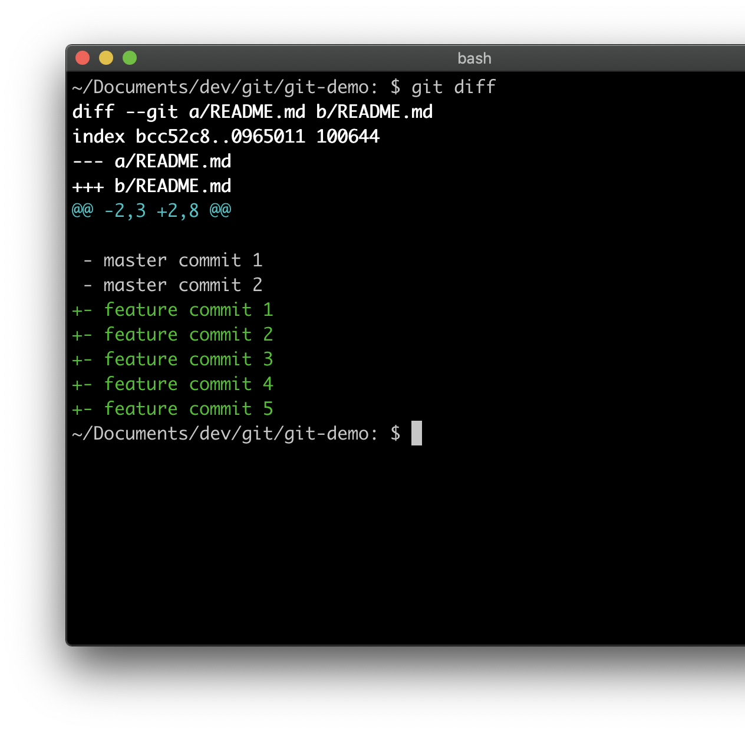
Preview changes before merging
git diff [source branch] [target branch]
git diff --staged [source branch] [target branch]
git diff 82c71ac adbc5b2

Slide 9
consider yourself warned

Slide 10
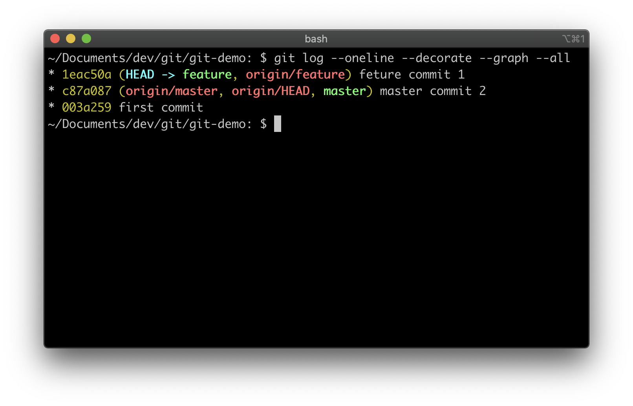

Add a change to the last commit
git commit --amend -m <message>
git push --force

Slide 11
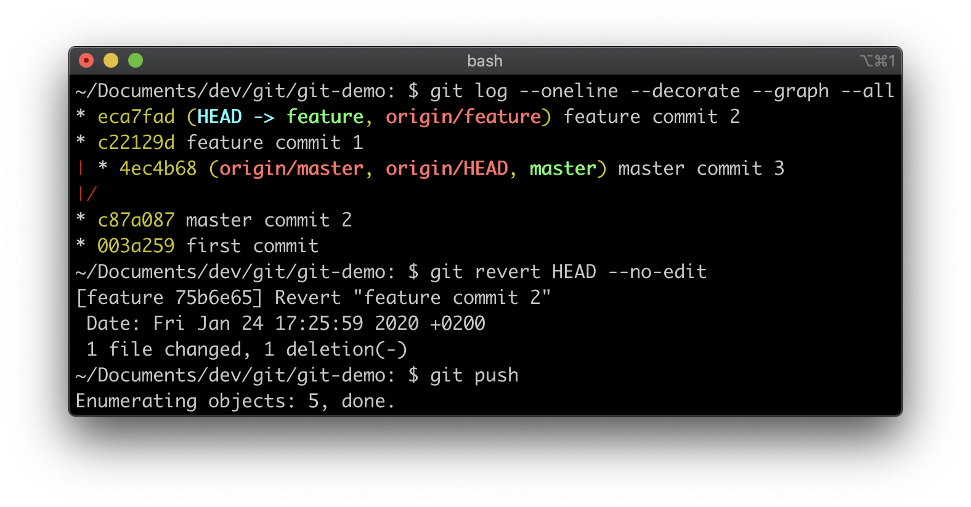
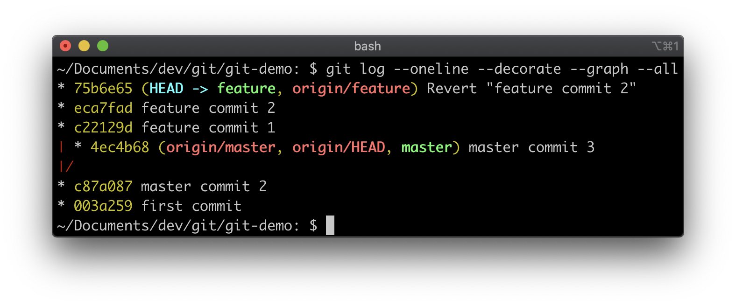
Soft cancel commits
git revert HEAD --no-edit
git push
or
git revert HEAD
git push

Slide 12
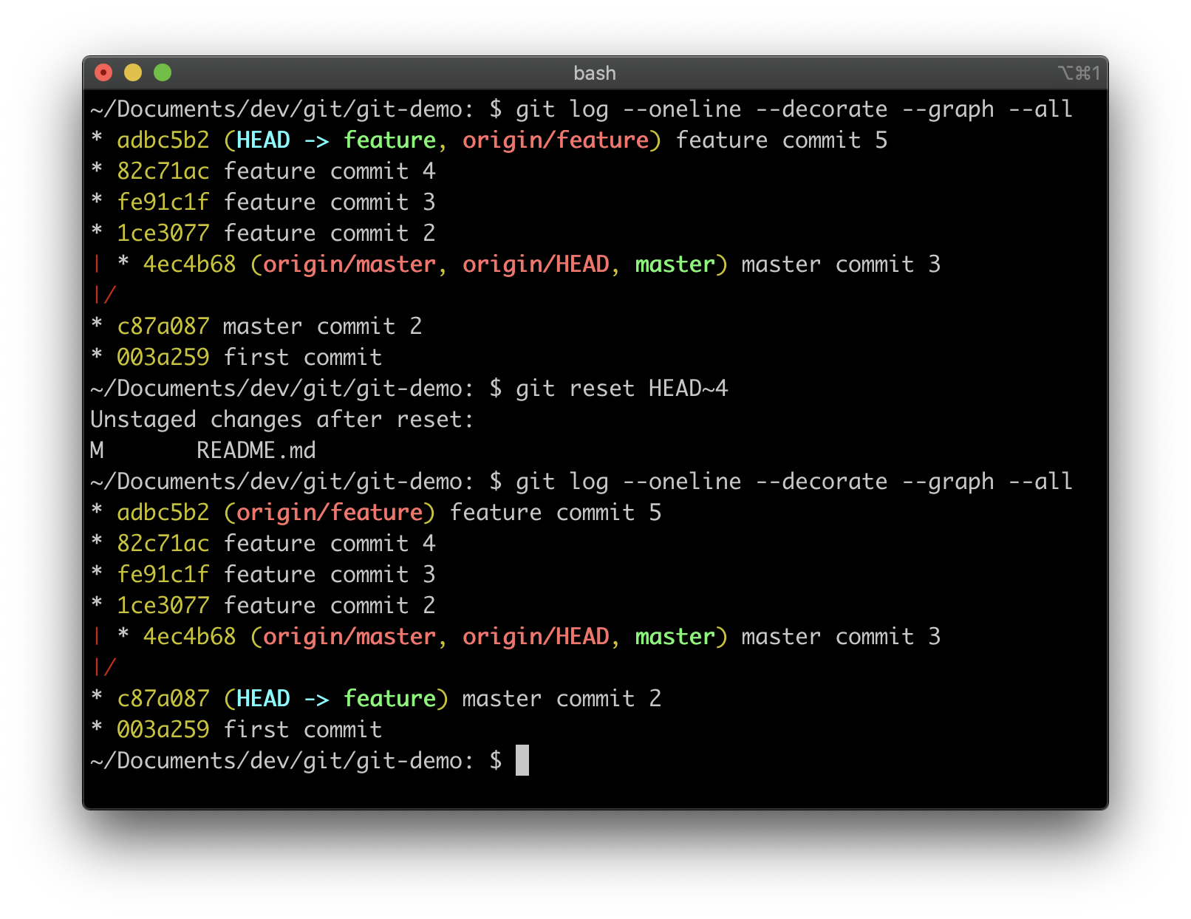
Squash some previous commits into one commit
git reset HEAD~4 git add .
git commit --amend <message>
git push --force
or
git reset c87a087 git add .
git commit --amend <message>
git push --force

Slide 13
GIT RESET
git reset --hard [HEAD~2 or c87a087] — deletes changes
git reset --soft [HEAD~2 or c87a087] — needs only to commit
git reset [--mixed] [HEAD~2 or c87a087] — needs add and commit

Slide 14
Get the most recent changes from another branch — Merge
git merge master
HEAD – feature →
fe91
4594
← master
003a
2faf
c87a
54a4
1913
c3ef

Slide 15
Get the most recent changes from another branch — rebase
git rebase master
… fix merge conflicts
git add .
git rebase --continue
HEAD – feature →
fe91
4594
← master
003a
2faf
c87a
54a4
1913
c3ef

Slide 16
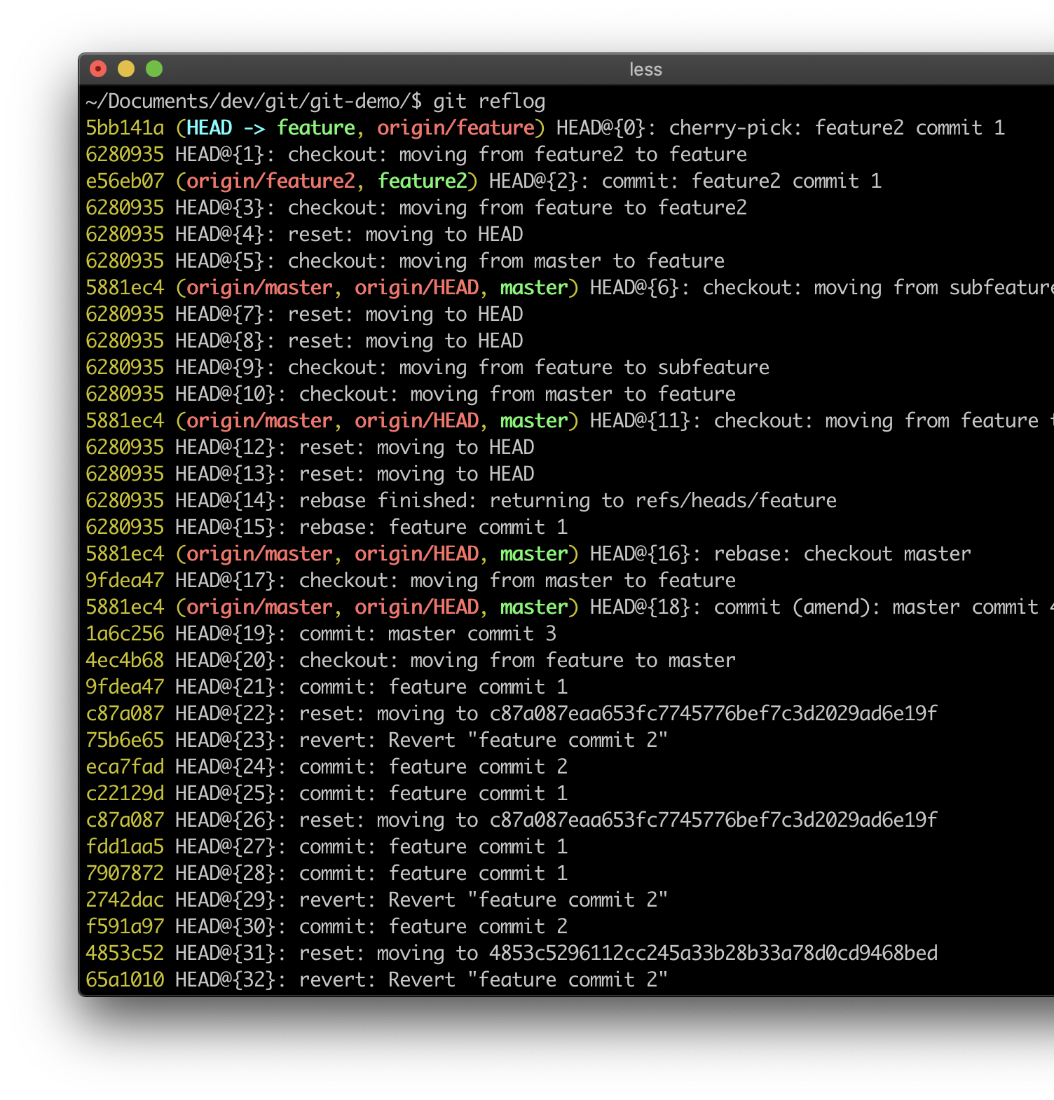
magic time machine
git reflog
you will see a list of everything you've done in git, across all branches!
each one has an index HEAD@{index} find the one before you broke everything
git reset HEAD@{index}

Slide 17
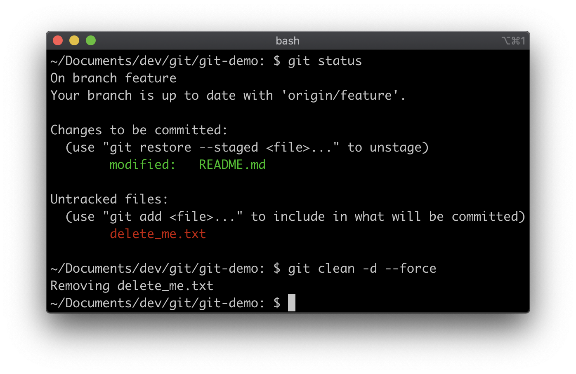
fight with the noise
git clean -d --force

Slide 18
Save your changes to the future
git stash [save] ["my_stash”]
git stash list
git stash pop [stash@{0}]
git stash apply [stash@{0}]
— save your changes
— list all your stashes
— apply a stash and remove it from the stash stack
— apply a stash and keep it in the stash stack

Slide 19
Copy commits
git cherry-pick <branch or commit>
git push
e56e
003a
c87a
4594
5bb1
54a4
c3ef

Slide 20
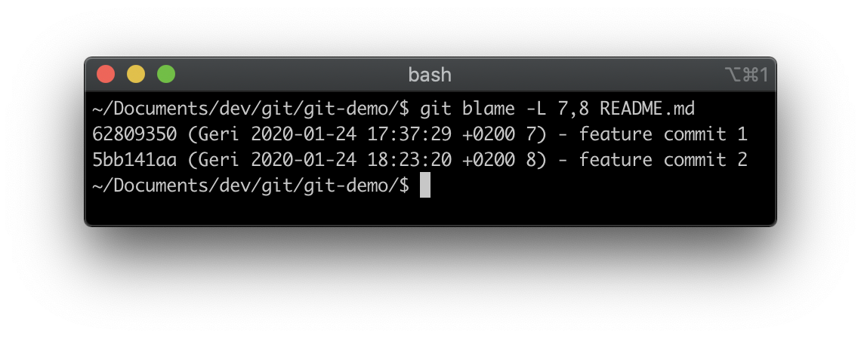
who did it?
git blame -L <start_line>,<end_line> <filename>

Slide 21
Delete local Branch
LOCAL BRANCH
git branch --delete <branch_name>
or
git branch --delete --force <branch_name>

Slide 22
Delete remote Branch
REMOTE BRANCH
git push origin --delete <branch_name>

Slide 23
Useful links
https://www.youtube.com/playlist?list=PLDyvV36pndZHkDRik6kKF6gSb0N0W995h
https://www.codementor.io/@citizen428/git-tutorial-10-common-git-problems-and-how-to-fix-them-aajv0katd
https://ohshitgit.com/
https://learngitbranching.js.org/

Slide 24
QUESTIONS

Slide 25
Thank you
https://gitlab.com/GregorHorvatH/git-common-problems
https://t.me/GregoryHorvath

